Slide 1
PPT模板下载：www.1ppt.com/moban/ 行业PPT模板：www.1ppt.com/hangye/
节日PPT模板：www.1ppt.com/jieri/ PPT素材下载：www.1ppt.com/sucai/
PPT背景图片：www.1ppt.com/beijing/ PPT图表下载：www.1ppt.com/tubiao/
优秀PPT下载：www.1ppt.com/xiazai/ PPT教程： www.1ppt.com/powerpoint/
Word教程： www.1ppt.com/word/ Excel教程：www.1ppt.com/excel/
资料下载：www.1ppt.com/ziliao/ PPT课件下载：www.1ppt.com/kejian/
范文下载：www.1ppt.com/fanwen/ 试卷下载：www.1ppt.com/shiti/
教案下载：www.1ppt.com/jiaoan/ PPT论坛：www.1ppt.cn
Hello
Python
Design a Spider for Wallpapers
Juncheng Li
Zhicheng Yan
Jingyu Du

Slide 2
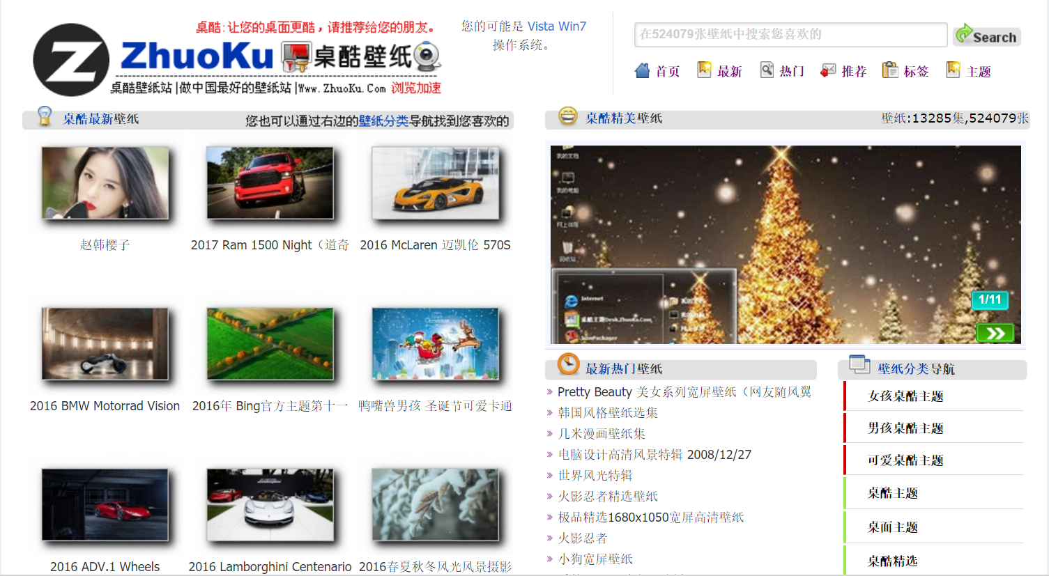
Background
http://www.zhuoku.com/
In normal situation, when you are going to download wallpapers from the Internet, you will find you can only download one picture for one time, even you need to wait for the picture to be loaded by the browser. It’s obviously very stupid. How about download the whole album for one time with python?
We pick a abroad wallpapers site to avoid copyright lawsuit.

Slide 3


Chrome – To view the source code
Package: urllib/requests – To fetch source code
Package: re – To build a proper RegEx
What you need?

Slide 4

Analyze the web page
Homepage
This wallpaper site has a tree structure. When you visit the homepage, you can choose the album you want. After entering an album, you need to enter each page of picture then download it. So the python code should be able to
Pics
Set
1
Pics
Set
…
Pics
Set
n
Pic
1
Pic
2
Pic
…
Pic
n
Pic
1
Pic
2
Pic
…
Pic
n
Pic
1
Pic
2
Pic
…
Pic
n

Slide 5
Build a Proper RegEx
Using Developer Tool of Chrome to view the source code
<a href="20161111011343(1).htm" target="_blank">
<img src="http://img.zhuoku.com/2016/11/11/angelababy/thumbs/tn_angelababy01.jpg" alt="Angelababy 杨颖【衣品天成】淘宝女装宽屏壁纸">
</a>
The .htm file marked with red is what we need. So we build a RegEx below:
reg = r'href="(.+?\.htm)" target="_blank"><img src="http://'
When we use re.findall() and set the RegEx as flag, we can get all the .htm file name from the source code. And we can use same method to get .jpg file in the .htm file. Then use urllib.urlretrieve() to download .jpg file to local.
For full RegEx library: https://docs.python.org/2/library/re.html

Slide 6
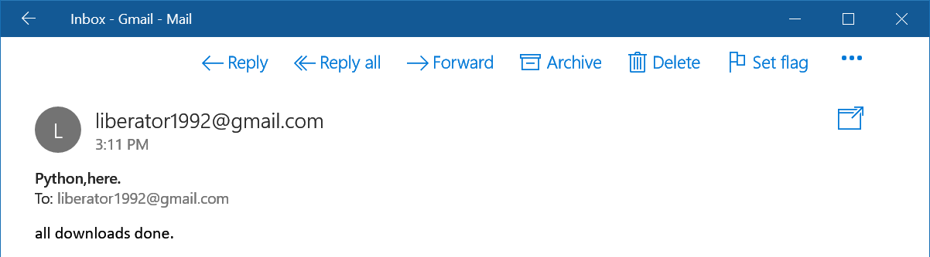
Add a Reminder
When the spider is running, you may leave the computer alone, go get something to eat or date someone. But how do you know when will the task complete or fail? So, you need a reminder. We can use smtplib package to send you an email.

Slide 7
Code and Demo
Lets go through the code shortly and try to get some wallpapers.

Slide 8
—— THANK YOU！ ——

